Slide 1


Matlab App Designer

Slide 2
Matlab App Designer
Folder
Import Data
Single File
Participant File Name
[X] Numerical and Graphical
Functionalities
Visualize Data
Joint Data (R/L)
[Y] Numerical and Graphical
Export Data
Walking Data (R/L)
[Z] Numerical and Graphical
Graph Visual
All Data/Some Data [Excel]

Slide 3
App Design
Most Important Information: User Feedback
Usability: How easily can you pick up this app and know how to use it?
Feasibility: Do the functions hinder or help?
Constraints: What needs to happen that doesn’t?

Slide 4
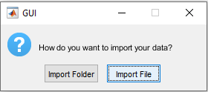
Xsens App
GUI (Graphical User Interface)
First window to pop up prompts you to select a Folder or an individual File

Slide 5
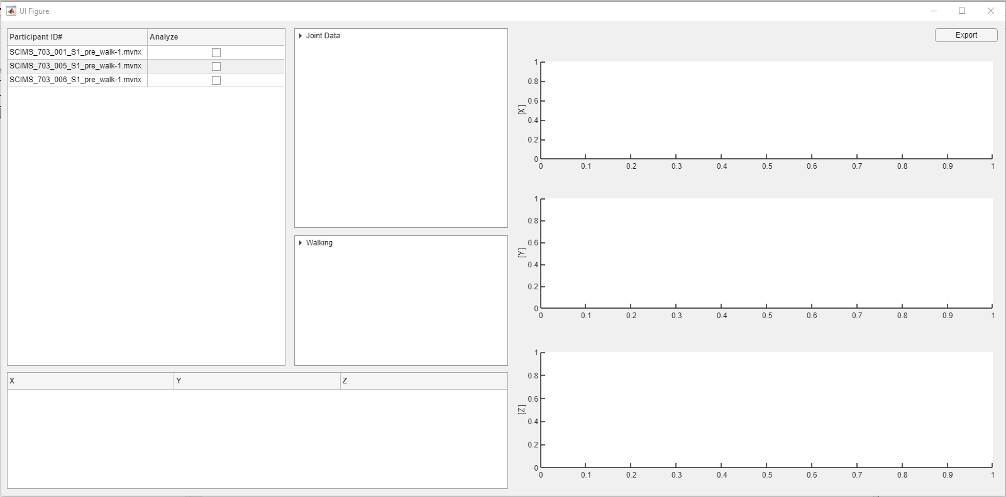
Check off the participant you want to analyze
Select the drop down for Joint Data
After selecting a folder (containing 3 files) this is the initial view to the right

Slide 6
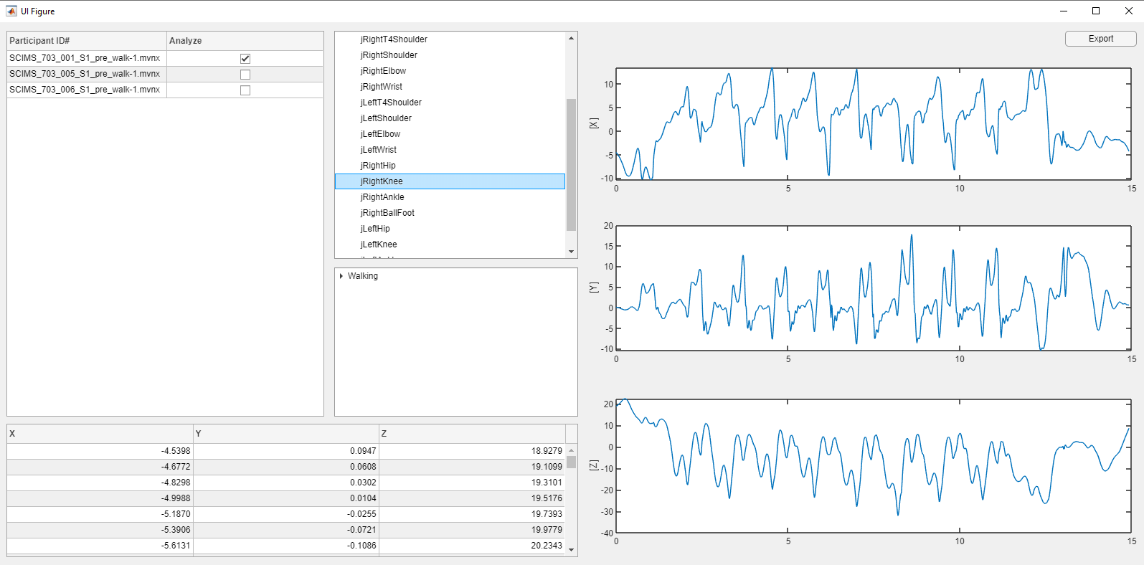
Select the joint you want to analyze
X,Y, Z Graphs will populate with raw Joint Data along with a table of values

Slide 7
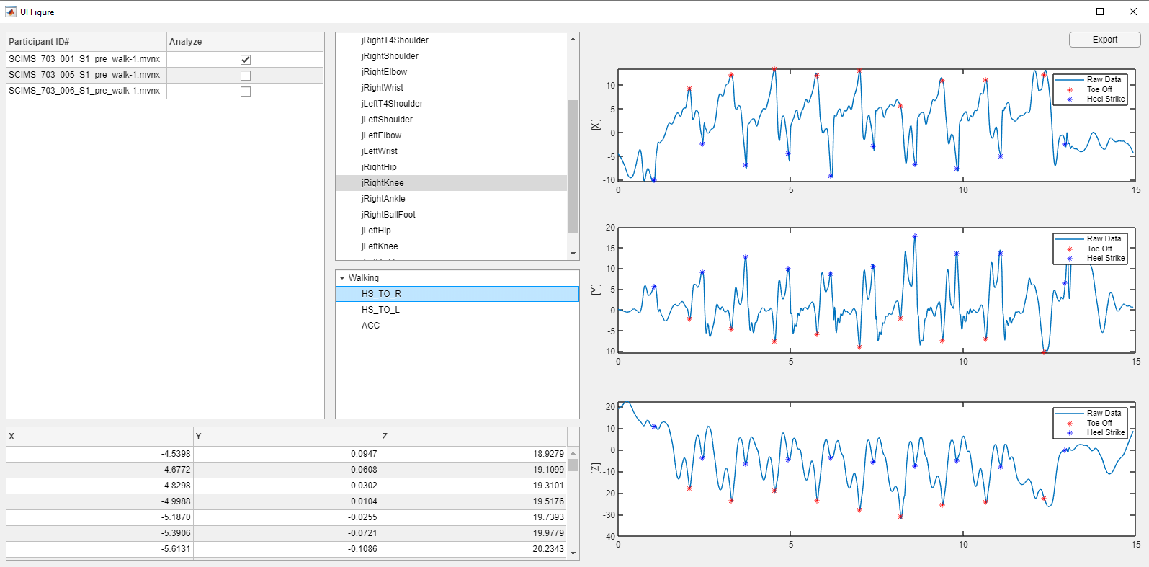
Select the drop down for Walking Data
X,Y, Z Graphs will populate with Toe Off and Heel Strike Locations

Slide 8
Xsens App
Usability: How easily can you pick up this app and know how to use it?
Feasibility: Do the functions hinder or help?
Constraints: What needs to happen that doesn’t?
Keep these questions in mind for the demonstration!

